Slide 1
Driver Drowsiness Detection Team No-12 Team Members: 1.Sai Sreeja(17H61A05G6) 2.Aditya Kumar(17H61A05F9) 3.Shiva Bharath(17H61A05C3) Guide: Mrs.Durga Bhavani Assistant Professor

Slide 2
Contents
Abstract
Introduction
Existing Approaches and Drawbacks
Motivation
Objectives
Methodology used
Tools and Technologies used
Conclusion
References

Slide 3
ABSTRACT
Drowsy driving occurs when a person who is operating a motor vehicle is too tired to remain alert.
Driver drowsiness detection is a car safety technology which helps prevent accidents caused by the driver getting drowsy.
We’ll implement the drowsiness detection algorithm detailed above using OpenCV, dlib, and Python.
Our solution to this problem is to build a detection system that identifies key attributes of drowsiness and triggers an alert when someone is drowsy before it is too late.

Slide 4
INTRODUCTION
A sleepy driver is arguably much more dangerous on the road than the one who is speeding as he is a victim of micro sleeps. Automotive researchers and manufacturers are trying to curb this problem with several technological solutions that will avert such a crisis. If the eye aspect ratio indicates that the eyes have been closed for a sufficiently long enough amount of time, we’ll sound an alarm to wake up the driver

Slide 5
EXISTING APPROACHES AND DRAWBACKS
Vehicle-Based Measures:-
In most cases, these measurements are determined in a simulated environment by placing sensors on various vehicle components, including the steering wheel and the acceleration pedal; the signals sent by the sensors are then analyzed to determine the level of drowsiness.

Slide 6
Behavioral Measures:-
Computerized, non-intrusive, behavioral approaches are widely used for determining the drowsiness level of drivers by measuring their abnormal behavior. Most of the published studies on using behavioral approaches to determine drowsiness focus on blinking.

Slide 7
Physiological Measures:-
The previously described vehicle-based and vision based measures become apparent only after the driver starts to sleep, which is often too late to prevent an accident. However, physiological signals start to change in earlier stages of drowsiness. Hence, physiological signals are more suitable to detect drowsiness with few false positives; making it possible to alert a drowsy driver in a timely manner and thereby prevent many road accidents.

Slide 8
MOTIVATION
During the last years there has been an increased interest in developing driver support systems that identify sleepiness. These systems normally consist of sensors for measuring physiological and behavioral changes, as well as algorithms to quantify such changes and predict risks. Lots of efforts have been addressed to this area.
However, less effort has been targeted at the warning strategies, and how to provide the driver with feedback and/or a warning in a way that the sleepy driver considers the received signals and actually does something to resolve the problem.

Slide 9
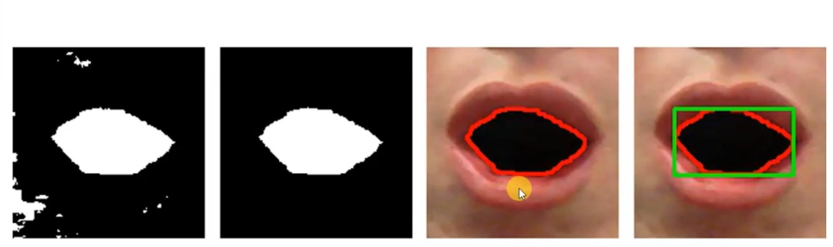
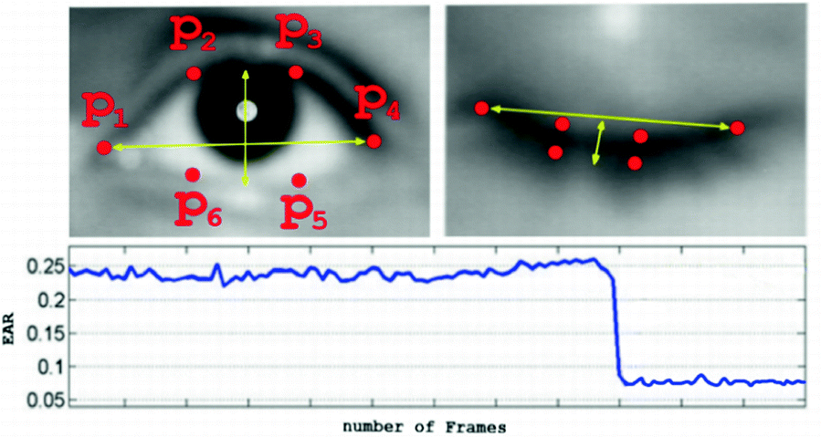
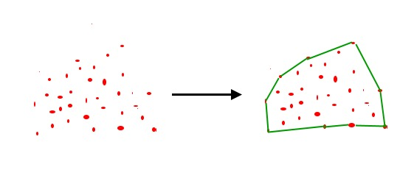
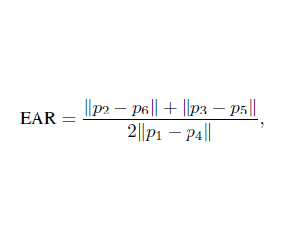
METHODOLOGY USED
We’ll implement the drowsiness detection algorithm detailed above using OpenCV, dlib, and Python.We calculate EAR Ratio for eyes and we use convex hull to find the distance and determine if an individual is yawning.

Slide 10
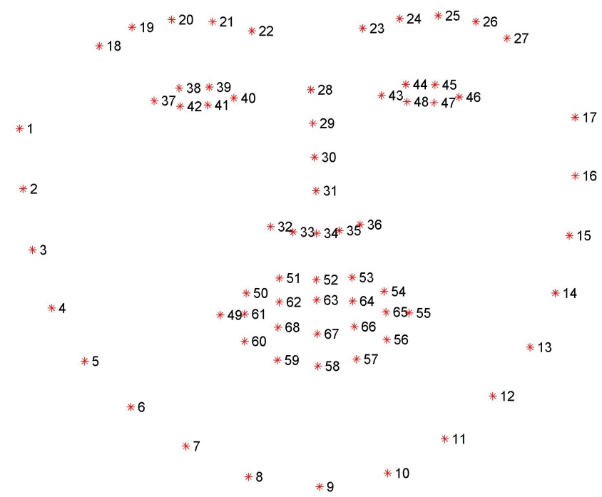
TOOLS USED
Python, Python Web Frame Works
OpenCV
Dlib
Imutlis Package
Scipy Package
PlaySound Library

Slide 11
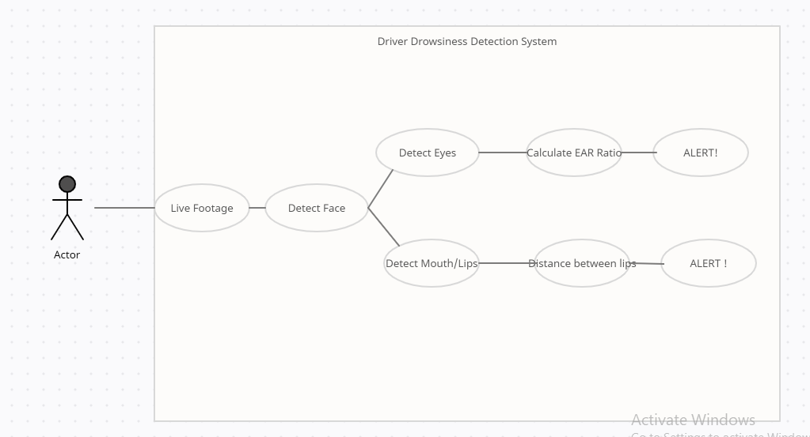
USE CASE DIAGRAM

Slide 12
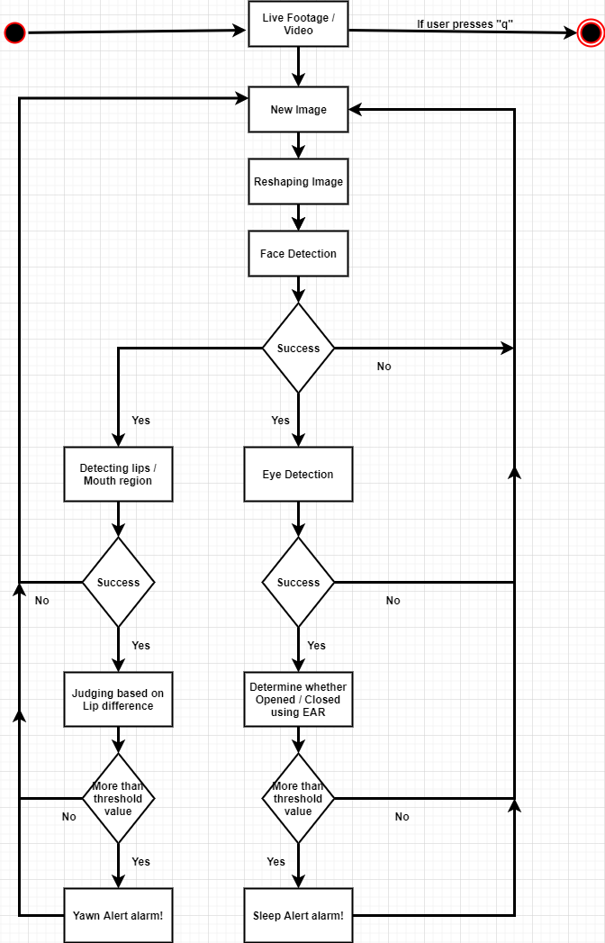
ACTIVITY DIAGRAM

Slide 13
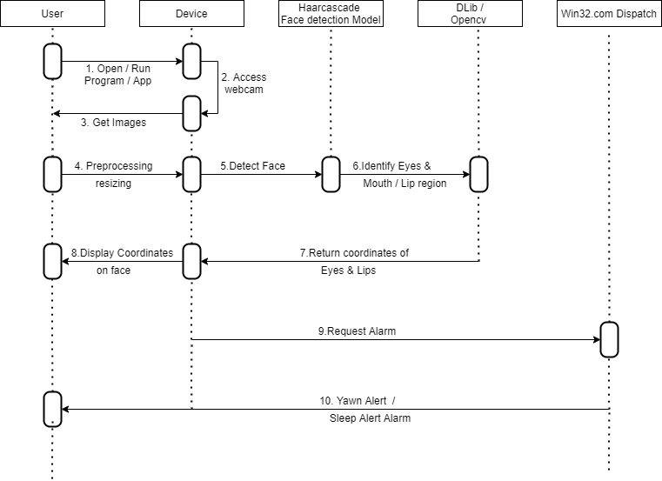
SEQUENCE DIAGRAM

Slide 14
CONCLUSION
To overcome the problem we came up with the solution implemented in the form of image processing.The role of the system is to detect facial landmark from images and deliver the obtained data to the trained model to identify the driver's state.
We recognized that everybody has a different baseline for eye aspect ratios and normalizing for each participant was necessary. Outside of runtime for our models, data pre-processing and feature extraction/normalization took up a bulk of our time.

Slide 15
REFERENCES
Åkerstedt, T. & Gillberg, M. 1990. Subjective and objective sleepiness in the active individual. Int J Neurosci, 52, 29–37.
Connor, J., Norton, R., Ameratunga, S., Robinson, E., Civil, I., Dunn, R., et al. 2002. Driver sleepiness and risk of serious injury to car occupants: population based case control study. Br. Med. J., 324 1125.
Dinges, D., Maislin, G., Brewster, R., Krueger, G. & Carroll, R. (2005). Pilot test of fatigue management technologies (No. Issue 1922): US Transportation Research Record.

Slide 16
TEAM NO-12
THANK YOU

